Slide 1
What is Effort?
Hard work
Trying your best
Determination
Work put in to achieve a goal
Think about giving your best EFFORT throughout the session, attend school, finish your work, and accomplish your goals!!

Slide 2
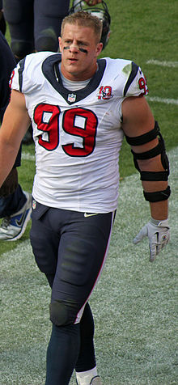
Who is J.J. Watt?
JJ Watt is a defensive end for the Houston Texans. He was drafted by the Texans in the first round of the 2011 NFL Draft. Watt played college ball at Wisconsin. As a high school athlete, Watt excelled in football, basketball, baseball, and track and field. He has received numerous awards and won the AP NFL Defensive Player of the Year twice. As you view the following video, think about the elements that make JJ so successful and the effort he puts in every day in the NFL (keep in mind this is after practice is already over for the day…)

Slide 3
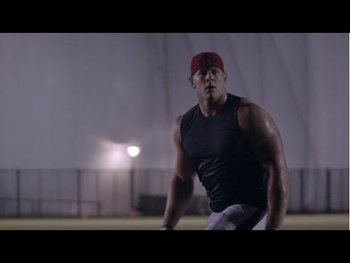

Slide 4
The epitome of effort on the field and in the community! J.J. Watt was named Walter Payton Man of the Year in 2018. In less than 3 weeks, Watt raised over 37 million for Hurricane Harvey relief. Watt began with a goal of $200K!!!
Think about the difference one person can make with effort and hard work.

