Slide 1
Honor
Honesty & Helpful
Use time appropriately and efficiently
Being trustworthy
Helping others in need (peers, teachers, staff, etc.)
Doing the right thing
Showing positive behavior at school

Slide 2
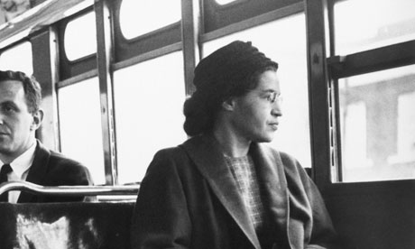
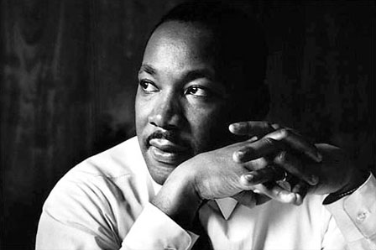
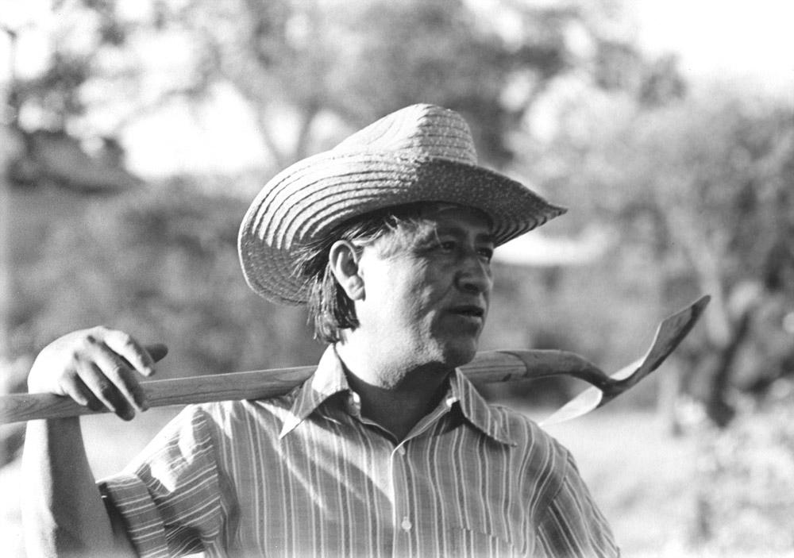
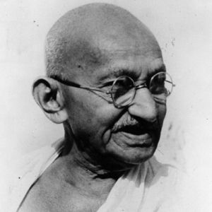
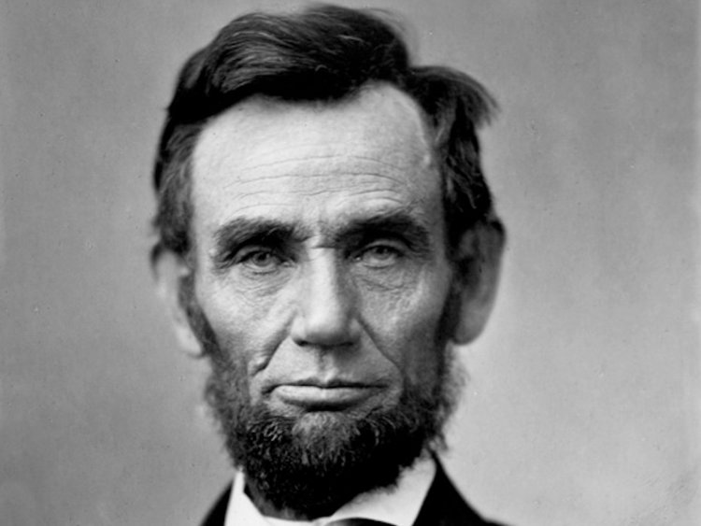
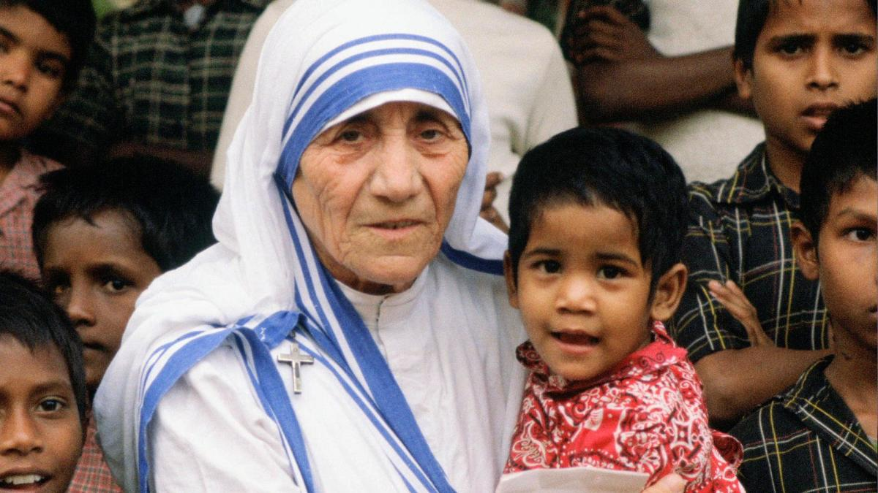

Slide 3
Response #1
All of these people are remembered for their honor. What does it mean to be a person of honor? How does being honorable impact others?

Slide 4
Response #2
How can YOU carry yourself with honor? What does that look like for you on a daily basis?

