Slide 1
Overcoming Obstacles
Challenge yourself to take a chance
Make a positive difference in everything you do
Learn from mistakes, overcome adversity
Ensure your contributions and comments are positive
✨ Never Give Up!! ✨

Slide 3
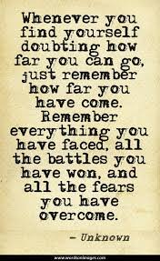
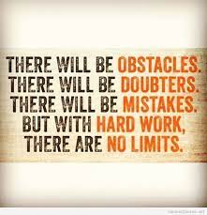
Discussion
What are some obstacles you may face in your life?
How can you work to overcome these obstacles?

